Slide 1
Implementation of a Microprocessor Emulator Platform with Limited Resources

Slide 2
Abstract
The project "Microprocessor Emulator" is an android application and Web application which is used to execute Microprocessor 8085 programs. This app/webapp provides simplest approach to type and execute microprocessor programs.
This app/web application also has some features like saving the code for future use, so as user can retrieve the code when needed. This application also has some basic as well as advance programs which helps users to learn Microprocessor.
We Develop Web application for Microprocessor Emulator using PHP.’
Storing program data in User Data Base. Built and Run programs in user Platform online, Comments and discussion about Programs and Project.

Slide 3
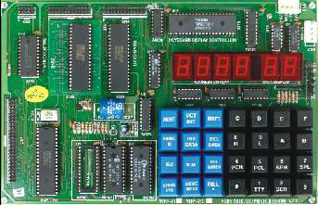
Existing System
The Emulator will automatically generate the instructions, and extract the commands, operands, and addresses Manually in hex code , and it gives a list of each assembly command line versus machine code line in memory address.

Slide 4
Proposed System
This system will help the Students by typing Assembly language code on their fingertips using smartphones and web site.
This application input is any Assembly language 8085 program Code.
When run the program it will check when user data is correct or not it means that given program found any errors or not. If found any mistake in code it won’t go next step show an popup message as mistake at particular line .if no errors it will go next step.

Slide 5
Advantages
This system will help the Students by typing Assembly language code on their fingertips using smartphones .
This application will convert to the given Assembly Code into Hex code.
The Webpages for this Emulator for store programs in database.
Program Discussion useful to overcome Errors .

Slide 6
Hardware and Software Requirements
Minimum Software and hardware Requirement Specifications:
Processor : Any Processor above 1 MHZ
Ram : 4 GB
Hard Disk : 250 GB
Operating System : Linux, Windows, Mac etc.
App Development Tool : Android Studio,(Phone Gap)optional.
Programming Lang : Java, Xml, PHP
Website Tool : Xampp(Php, MySQL, Apache Server).

Slide 7
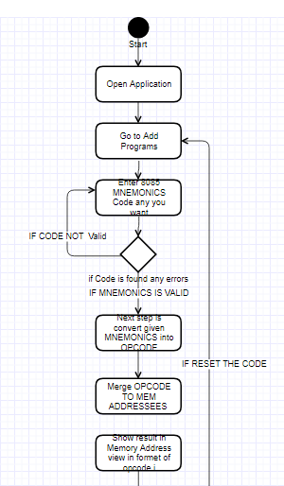
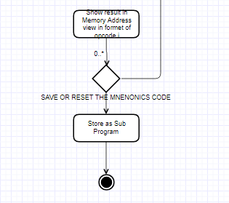
Architecture

Slide 8
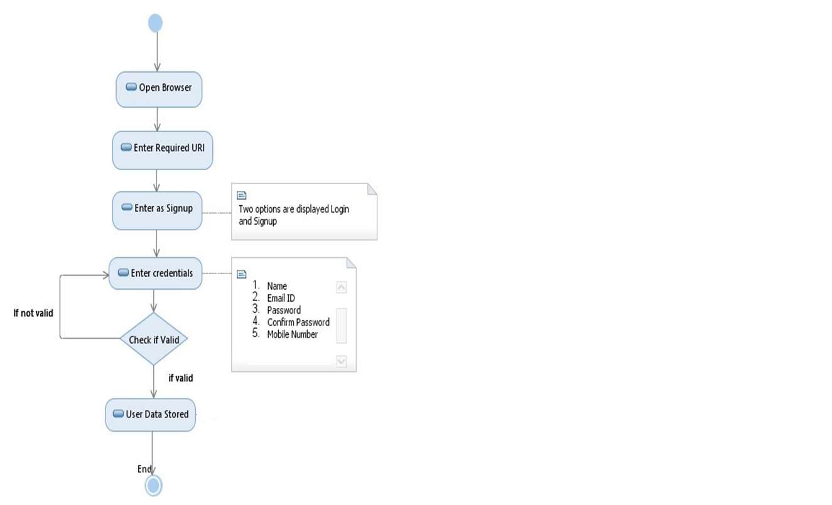
Activity Diagram

Slide 9
Thank you

